Slide 1

Sinhgad College of Engineering, Pune – 41.
Department of Electronics &Telecommunication Engineering
“Design and development of Drunk and Drive Using GSM ”
By
NAME- Seat No
(1)Hrushikesh Shelke 304A055
(2)Sambhav Saklecha 304A053
Guide
Prof. M.N.KAKATKAR
03/06/21

Slide 2
CONTENTS
Introduction
Problem Statement
Objective
Literature Survey
Block Diagram
Selection Criterion of Components
Design Specifications and Calculations
Flowchart/Algorithm
Simulation and Testing
Demonstration and Results
Conclusion
Future Scope
REFERENCES
03/06/21
Sinhgad College of Engineering, Pune – 41.
Department of Electronics &Telecommunication Engineering

Slide 3
Introduction
Road safety has become a major public health concern.
If person is dunked and driving vehicle he is not in a position to handle emergency situations
Thus drunken driving is most common reason of accidents in almost all countries all over the world. This system should be installed in the vehicle.
This proposed system Drunk and Drive Detection to detect the drunken drivers and control their vehicles to reduce the accidents.
Driving under the influence of alcohol or drugs can have serious consequences, including injuring or killing another person
03/06/21
Sinhgad College of Engineering, Pune – 41.
Department of Electronics &Telecommunication Engineering

Slide 4
Problem Statement
“To Design and Implement Drink and Drive System for Alcohol Detection”
03/06/21
Sinhgad College of Engineering, Pune – 41.
Department of Electronics &Telecommunication Engineering

Slide 5
Objective
The main objective of this project is to sense drunken driver automatically to stop accidents for automobiles.
The proposed system uses an alcohol sensor to sense the drunken person
To implement GSM technology with an alcohol detector.
So Alcohol detection & text SMS will inform the relatives or owners of the vehicle about the alcohol consumption.
03/06/21
Sinhgad College of Engineering, Pune – 41.
Department of Electronics &Telecommunication Engineering

Slide 6
Literature Survey (1/2)
Sr. No | Authors | Proposed Method | Advantages | Disadvantages
1. | Rachita Shettar ,Sandeep Dabhade, Basavaraj Viraktamath , Amit Dalal , Varsha B Vannur | accelerometer circuit which is used for detection of drowsiness and second is alcohol sensor circuit which is used for detection and control of a vehicle due to alcohol consumption. | accelerometer sensor can be used to check a person is properly driving . | Controlling break system is dangerous attempt
2. | Pranjali Ingalepatil, Priyanka Barhate, Bhagyashri Nemade, Vijay D. Chaudhari | Ignition Control if alcohol level increases threshold | Small in size and low cost | Ignition control may be dangerous
Sinhgad College of Engineering, Pune – 41.
Department of Electronics &Telecommunication Engineering
03/06/21

Slide 7
Literature Survey(2/2)
Sr. No | Authors | Proposed Method | Advantages | Disadvantages
3. | Supraja A, Bhanu Sri , Mary Posonia A | Uses GPS Module to send location when alcohol level is above threshold | GPS Module is better way to send information | GPS module requires good range to operate. In case device is placed where there is no range, system is in effective
4. | Pratiksha Bhuta, Karan Desai, Archita Keni, Vijayalakshmi Badre | Uses GPS Module to send location and GSM module to send text when alcohol level is above threshold | GPS Module is better way to send information | System is bulky Requires more power to operate
03/06/21
Sinhgad College of Engineering, Pune – 41.
Department of Electronics &Telecommunication Engineering

Slide 8
Literature Survey(2/2)
Sr. No | Authors | Proposed Method | Advantages | Disadvantages
5. | Melanie Anthony, Ruchi Varia, Arjun Kapadia, Mrinmoyee Mukherjee, | Uses GSM Module to send message if alcohol level exceeds | Low cost Compact in size | No lcd or display is used . The data is displayed on serial window of arduino
03/06/21
Sinhgad College of Engineering, Pune – 41.
Department of Electronics &Telecommunication Engineering

Slide 9
Block Diagram
GSM
Module
Power Supply Unit 5V , 1 A
Power Supply 12 V , 2 A
MQ3 Sensor
LCD DISPLAY
Arduino Uno
Buzzer
Light Emitting Diode
Fig1 Block Diagram of drink and drive
03/06/21
Sinhgad College of Engineering, Pune – 41.
Department of Electronics &Telecommunication Engineering

Slide 10
Selection Criterion of Components
Arduino Uno Board is easy to program as it contains Atmega 328P Microcontroller. It is possible to program it using Arduino IDE which is free to use
MQ3 gas sensor is widely used in detecting many gases. It is very small in size, low cost and consumes less power.
We use 16 x 2 lcd to display the sensor values and device status. LED and Buzzer are used as indicators in case of emergency
GSM Module is use as it uses AT commands to sends message in case of any emergency.
03/06/21
Sinhgad College of Engineering, Pune – 41.
Department of Electronics &Telecommunication Engineering

Slide 11
Design Specifications and Calculations
Arduino Uno: requires 5V and 200 mA current for its operation
MQ3 gas sensor requires 5V and 150 mA current for its operation
LED : Forward voltage 1.2V to 3.6V, 10mA to 30mA
Buzzer: 5V, 30 mA
GSM Module: 12V, 2A; requires external adapter
Thus we require a linear power supply of 5v and 1A rating
03/06/21
Sinhgad College of Engineering, Pune – 41.
Department of Electronics &Telecommunication Engineering

Slide 12
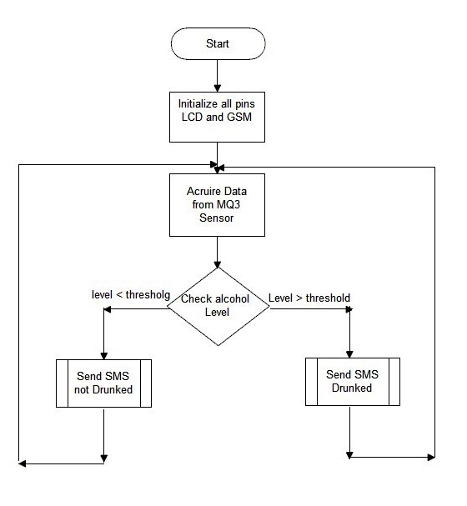
Flowchart/Algorithm
Fig 2 Flowchart
03/06/21
Sinhgad College of Engineering, Pune – 41.
Department of Electronics &Telecommunication Engineering

Slide 13
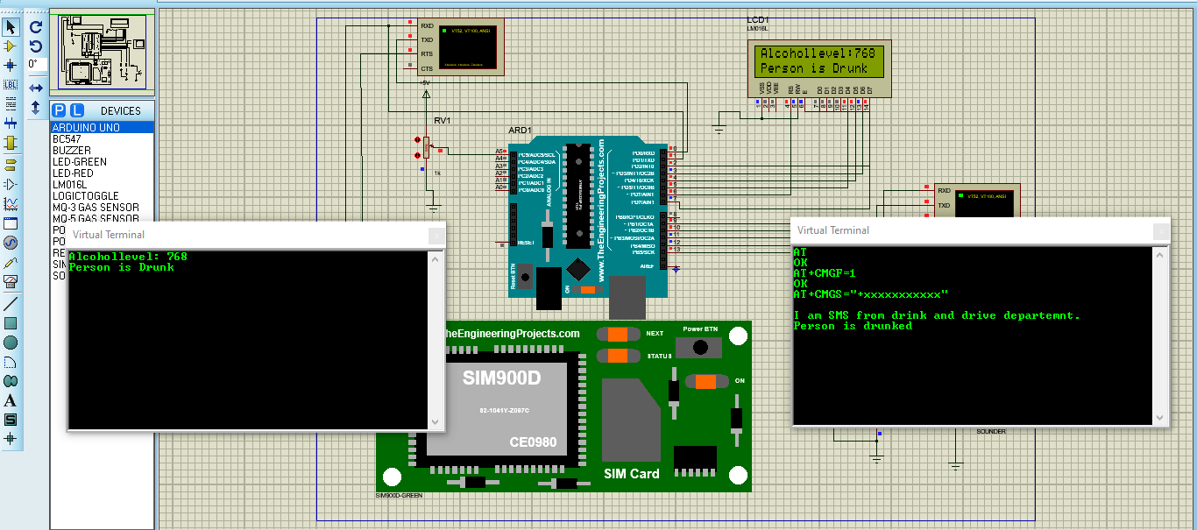
Simulation and Testing
Fig3 Simulation
03/06/21
Sinhgad College of Engineering, Pune – 41.
Department of Electronics &Telecommunication Engineering

Slide 14
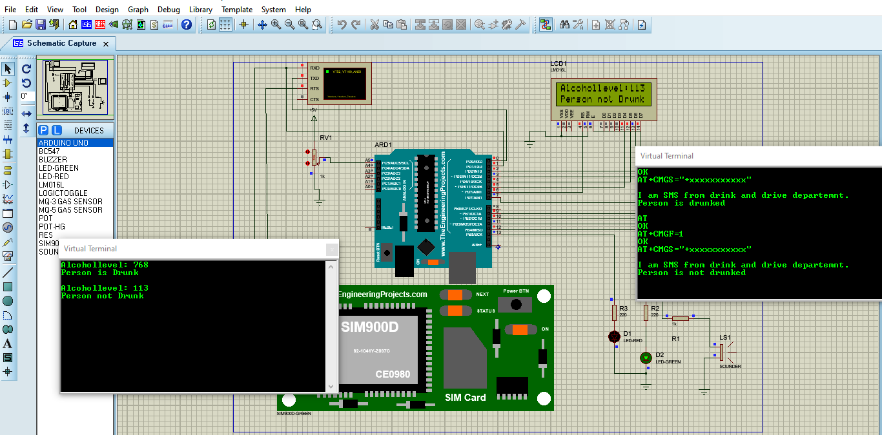
Result
Fig4 Result drink and drive
03/06/21
Sinhgad College of Engineering, Pune – 41.
Department of Electronics &Telecommunication Engineering

Slide 15
Advantages
When the drunken driver enters in the vehicle alcohol sensor senses the alcohol, therefore buzzer rings and LCD displays that alcohol is detected
Quick and accurate results.
Easy and efficient to test the alcohol content in the body
Helpful for police and provides and automatic safety systems for cars and other vehicles as well.
03/06/21
Sinhgad College of Engineering, Pune – 41.
Department of Electronics &Telecommunication Engineering

Slide 16
Applications
The applications of automatic drunk and drive avoiding system to include cars, buses, trucks, etc
The above-proposed system can also be implemented in two wheelers.
This project can also be used in various companies or organizations to detect alcohol consumptions of employees.
03/06/21
Sinhgad College of Engineering, Pune – 41.
Department of Electronics &Telecommunication Engineering

Slide 17
Conclusions
An effective solution is provided to develop the intelligent system for vehicles which will monitor various parameters of
vehicle in-between constant time period and will send this data to the base unit as explained
Using hardware platform who’s Core is Arduino, Alcohol sensor mq3, GPS & GSM module.
The designed system would finish the function of communicating with the base station via GSM
The whole Control system has the advantage of small volume and high reliability.
03/06/21
Sinhgad College of Engineering, Pune – 41.
Department of Electronics &Telecommunication Engineering

Slide 18
Future Scope
We can implement GPS technology so that once alcohol detection is done, the system will find out the location of the vehicle.
It is also possible to extend our project work for GPS tracker and alcohol detector with engine locking system using GSM
03/06/21
Sinhgad College of Engineering, Pune – 41.
Department of Electronics &Telecommunication Engineering

Slide 19
REFERENCES
Rachita Shettar, Sandeep Dabhade, Basavaraj Viraktamath, Amit Dalal and Varsha B. Vannur, ”Design and Development of Accident Prevention and Control system”, International Journal of Engineering Research and Technology, Volume 4, Issues 05, May 2015
Pranjali Ingalepatil, Priyanka Barhate, Bhagyashri Nemade, Vijay D. Chaudhari, “Alcohol Detection System in Vehicle using Arduino”, International Journal of Engineering Research and Technology, Volume 4, Issues 06, May 2017
Supraja A, Bhanu Sri , Mary Posonia A , “DRUNK AND DRIVE DETECTION USING IOT”, International Journal of Pure and Applied Mathematics, Volume 118, No. 20 ,2018.
Pratiksha Bhuta, Karan Desai, Archita Keni, Vijayalakshmi Badre, “Alcohol Detection and Vehicle Controlling”, International Journal of Engineering Trends and Applications (IJETA) – Volume 2 Issue 2, Mar-Apr 2015
Melanie Anthony, Ruchi Varia, Arjun Kapadia, Mrinmoyee Mukherjee, “Alcohol Detection System to Reduce Drunk Driving”, International Journal of Engineering Research & Technology (IJERT), Special Issue - 2021
03/06/21
Sinhgad College of Engineering, Pune – 41.
Department of Electronics &Telecommunication Engineering

Slide 20
5. Po Yuch Chen and Hung Ju Lin, “A DWT Based Approach for Image Steganography”, International journal of Applied Science and Engineering, Vol.4, No.3, 2006, pp. 275-290.
6. P.Mohan Kumar and D.Roopa, “An Image Steganography Framework with Improved Tamper Proofing”, Asian Journal of Information Technology, Vol. 6, No.10, 2007, pp.1023-1029.
7. Joachim J. Eggers, R.Bauml and Bernd Girod, “A Communications Approach to image steganography”, Proc. of SPIE Volume 4675, San Jose, Ca, 2002, pp. 1-12.
8. Mohammed A.F Al-Husainy, “Image Steganography by mapping Pixels to letters”, Journal of Computer science, Vol.5, No.1, 2009, pp. 33-38.
Thank You !!
03/06/21
Sinhgad College of Engineering, Pune – 41.
Department of Electronics &Telecommunication Engineering

